Slide 1


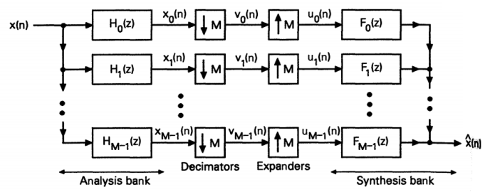

Implementation Three Channel Filter Bank Signal Reconstruction
Mohammad Reza
Mansouri

Slide 2
Introduction
1
In the simulation, for simplicity in design, coding is divided into two sections: analysis and synthesis.

Slide 3
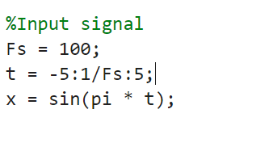
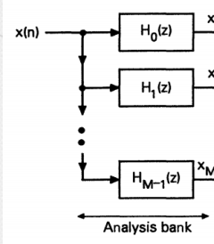
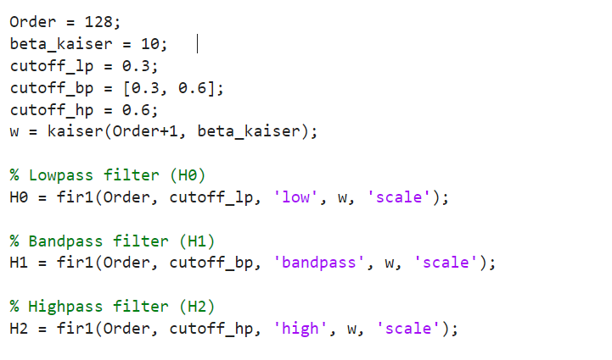
analysis
analysis
2

Slide 4
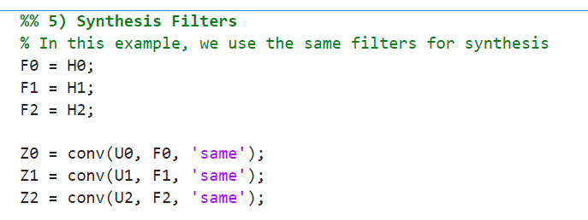
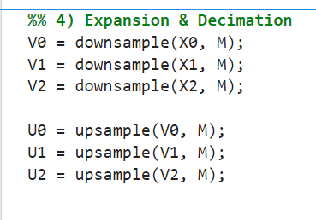
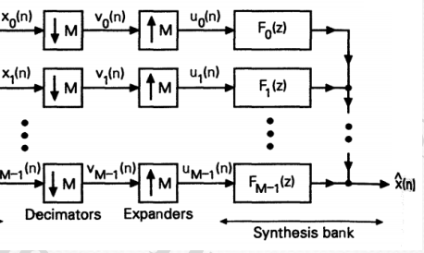

synthesis
2

Slide 5
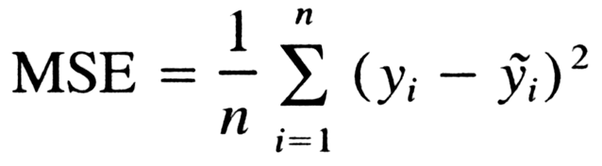

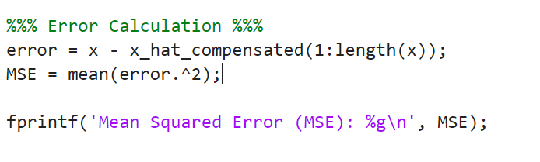
MSE
3

Slide 6


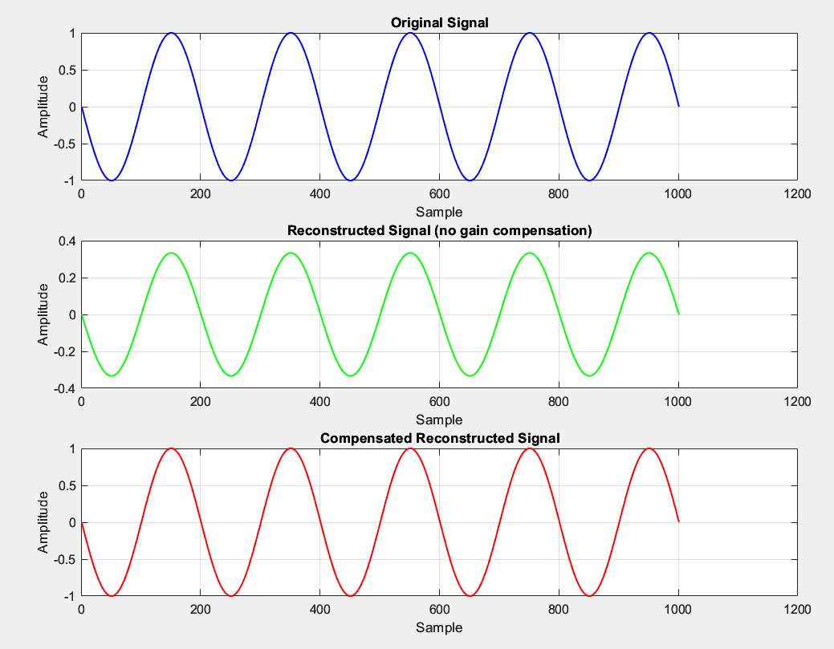
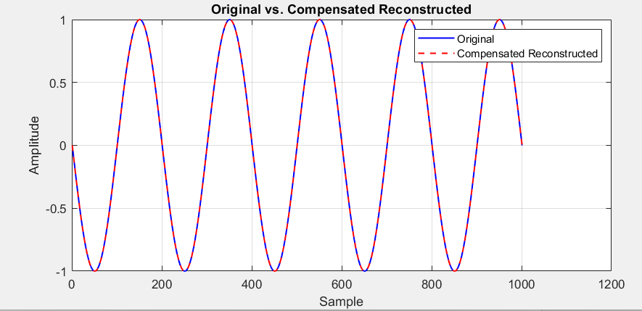
Results
3
The results are accurate, and the error between the input signal and the reconstructed signal is zero.

